Slide 1
Children and their Parents’ Labor Supply: Evidence from Exogenous Variation in Family Size
Angrist and Evans 1998
Discussion by Jeff Denning

Slide 2
What is the question? Why is this interesting?
How does family size affect labor supply of parents?
Can this explain the change in female labor force participation?
Labor economists are very interested in the decision to work and the consequences of that decision.
Historically many labor questions focused on men because modeling the decision to work complicates models of LFP. This is a notable example that considers women

Slide 3
Why is this difficult to answer?
Family size is not randomly assigned.
Women who decide to have more children are likely different from women with fewer children. E.g. education, religion, etc
Comparing women who have more kids to women with fewer likely adds a lot of selection bias

Slide 4
So we need something else
This paper would be a “quasi-experiment” or a “natural experiment”
This is where there is “as good as” random variation rather than literal randomization

Slide 5
What does this paper do?
Leverages the insight that people like to have children of different sexes.
This provides variation in family size that is “as good as random”
Use this variation as an instrument for labor force outcomes.

Slide 6
Validity of Instrument
First Stage/Relevance-Does having children of the same gender affect the probability of having a 3rd child? Yes 6 percentage points more likely
Who are compliers?

Slide 7
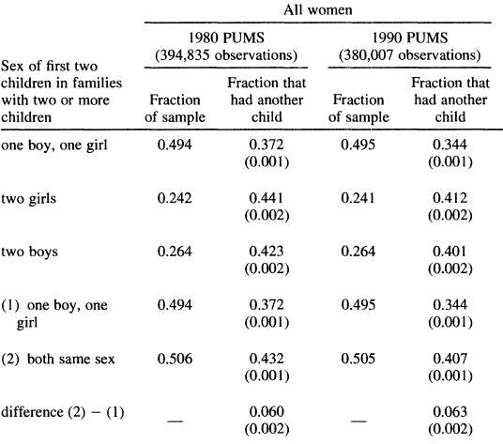
Table 3

Slide 8
Independence?
Is it random who has same-sex children?
Probably
What would be a problem?
Sex-selective abortion. Abrevaya (2009) demonstrates this is true in the US
Other problems?
Can check for some of this

Slide 9
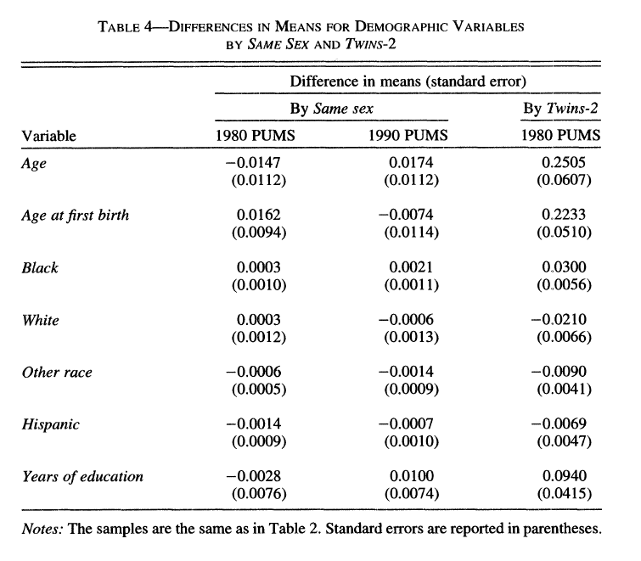

Slide 10
Exclusion?
Can having same sex children affect labor supply in some other way?
There is some evidence that fathers are more involved parents if they have a boy.
Maybe 2 boys always fight with each other so it requires more attention
This motivates the use of controlling for the gender of the first kid and the specification that uses two boys and two girls as the instrument instead of 1 indicator for same-sex children

Slide 11
Monotonicity
Can having two children of the same gender decrease the number of children?
Probably not--but certainly possible
Hence we can interpret this estimate as a LATE

Slide 12
What do they find?
Having another child negatively affects the probability of working, weeks worked, hours a week, and labor income for mothers.
Not much effect on husbands
The estimates are smaller than the OLS. What does this tell us about the selection into having children?

Slide 13
Wald Estimate
Divide the change in outcome for mothers with two same sex children by the change in the number of children.
A very nice, intuitive way to show what is happening

Slide 14
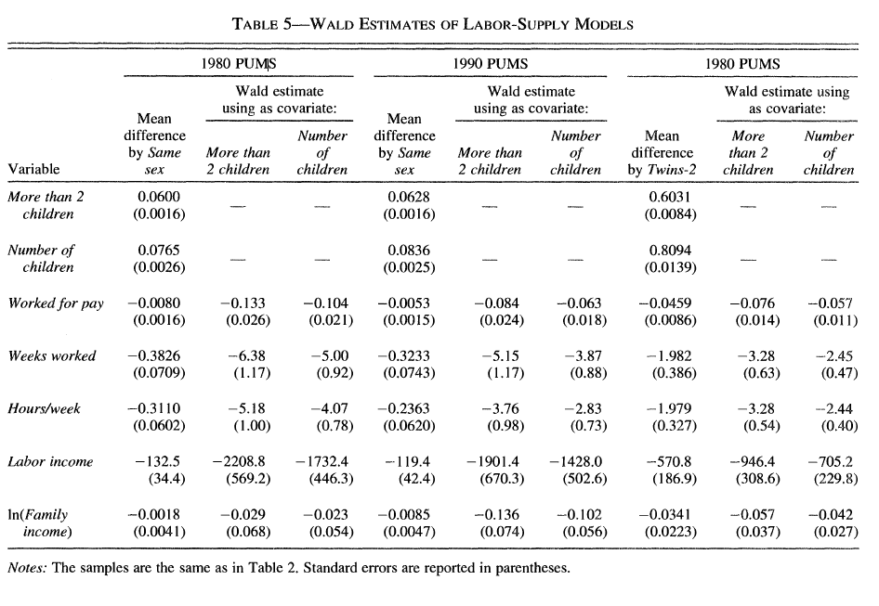

Slide 15
More results
The results are stronger for women with less education
The authors also compare to twins instrument which has similar patterns

Slide 16
Interpretation
This paper does a good job establishing that more children affects labor supply of women.
BUT, who is this relevant for?
The sample is women with at least 2 children.
Is this likely the right estimate for a woman’s first child?

Slide 17
Interpretation 2
What do the authors do to address this?
They show that roughly half of women age 28-35 fall into this group
Who are the compliers? People who like having a child of each sex.

Slide 18
Conclusion
Family size has a causal effect on female labor supply
IV can be used in settings that are not about RCT compliance
Natural experiments can yield causal estimates if several conditions are met

